Slide 1
Unit 2 Authentication
By
Prof. Pranita Binnar (Research Scholar, Ph.D. Pursuing)
Visiting Faculty, Dept. of Computer Engineering
NMIMS, Navi Mumbai Campus
Email Contact – pranitasadgir@gmail.com
Contact No. - 9699502992

Slide 2
Topics to be covered
Authentication basics
Password
Challenge response
Biometrics
SSO

Slide 3
Authentication basics
Definition - Authentication is the binding of an identity to subject.
Subjects act on behalf of some other, external entity.
The identity of that entity controls the actions that its associated subjects may take.
Hence, the subjects must bind to the identity of that external entity.

Slide 4
Authentication basics
The external entity must provide information to enable the system to confirm its identity. This information comes from one (or more) of the following.
1. What the entity knows (such as passwords or secret information such as PIN, Social security number, Mother’s maiden name, Date of birth, Name of your pet, etc.)
2. What the entity has (such as a badge or card or tokens)
3. What the entity is (such as fingerprints or retinal characteristics)
4. Where the entity is (such as in front of a particular terminal)

Slide 5
Authentication Process
The authentication process consists of obtaining the authentication information from an entity, analyzing the data, and determining if it is associated with that entity.
This means that the computer must store some information about the entity. It also suggests that mechanisms for managing the data are required. We represent these requirements in an authentication system consisting of five components.

Slide 6
Authentication System
1. The set A of authentication information is the set of specific information with which entities prove their identities.
2. The set C of complementary information is the set of information that the system stores and uses to validate the authentication information.
3. The set F of complementation functions that generate the complementary
information from the authentication information. That is, for f ∈ F, f: A → C.
4. The set L of authentication functions that verify identity. That is, for l ∈ L,
l: A × C→{ true, false }.
5. The set S of selection functions that enable an entity to create or alter the
authentication and complementary information.
The goal of an authentication system is to ensure that entities are correctly identified. If one entity can guess another’s password, then the guesser can impersonate the other.

Slide 7
Example
A user authenticates himself by entering a password, which the system compares with the cleartext passwords stored online. Here, A is the set of strings making up acceptable passwords,
C = A, F = { I }, and L = { eq }
where I is the identity function and eq is true if its arguments are the same and false if they are not.
Notes:
set A of authentication information , set C of complementary information , set F of complementation functions , set L of authentication functions

Slide 8
Passwords
Definition : A password is information associated with an entity that
confirms the entity’s identity.
Passwords are an example of an authentication mechanism based on what people know: the user supplies a password, and the computer validates it.
If the password is the one associated with the user, that user’s identity is authenticated.
If not, the password is rejected and the authentication fails.

Slide 9

Password
The simplest password is some sequence of characters. In this case, the password space is the set of all sequences of characters that can be passwords.
EXAMPLE: One installation requires each user to choose a sequence of 10 digits as a password. Then A has elements (from “0000000000” to “9999999999”).

Slide 10
Why Passwords?
Why is “something you know” more popular than “something you have” and “something you are”?
Cost: passwords are free
Convenience: easier for sysadmin to reset pwd than to issue a new thumb
Notes:
o eliminate this vulnerability, newer Linux systems use the /etc/shadow file to store user passwords instead. Traditional password files are maintained in /etc/passwd, but the actual hashed passwords are stored in /etc/shadow.
Press "Enter" to open up the registry editor to find Windows 10 password in registry. To get to the password, navigate to HKEY_LOCAL_MACHINE\SOFTWARE\Microsoft\Windows NT\CurrentVersion\Winlogon and scroll down to "DefaultPassword." When you double-click on that, a window should pop up that reveals the stored password

Slide 11
Good and Bad Passwords
Bad passwords
frank
Fido
Password
incorrect
Pikachu
102560
AustinStamp
Good Passwords?
jfIej,43j-EmmL+y
09864376537263
P0kem0N
FSa7Yago
0nceuP0nAt1m8
PokeGCTall150

Slide 12
Attacks on Passwords
Attacker could…
Target one particular account
Target any account on system
Target any account on any system
Attempt denial of service (DoS) attack
Common attack path
Outsider → normal user → administrator
May only require one weak password!

Slide 13
Password Attacks
Phishing. Phishing is when a hacker posing as a trustworthy party sends you a fraudulent email, hoping you will reveal your personal information voluntarily. ...
Man-in-the-middle attack. Man-in-the middle (MitM) attacks are when a hacker or compromised system sits in between two uncompromised people or systems and deciphers the information they're passing to each other, including passwords.
Brute force attack. a brute-force attack consists of an attacker submitting many passwords or passphrases with the hope of eventually guessing correctly. The attacker systematically checks all possible passwords and passphrases until the correct one is found.

Slide 14
Password Attacks
Dictionary attack. A dictionary attack is a systematic method of guessing a password by trying many common words and their simple variations
Credential stuffing. Credential stuffing is a type of cyberattack in which stolen account credentials, typically consisting of lists of usernames and/or email addresses and the corresponding passwords (often from a data breach), are used to gain unauthorized access to user accounts through large-scale automated login requests directed against a web application
Keyloggers. a computer program that records every keystroke made by a computer user, especially in order to gain fraudulent access to passwords and other confidential information.

Slide 15
Attacking a Password System
A dictionary attack is the guessing of a password
Countering Password Guessing
Random Selection of Passwords
Pronounceable and Other Computer-Generated Passwords
User Selection of Passwords
Reusable Passwords and Dictionary Attacks
Password Aging

Slide 16
Attacking a Password System
The simplest attack against a password-based system is to guess passwords.
Definition : A dictionary attack is the guessing of a password by
repeated trial and error.
The name of this attack comes from the list of words (a “dictionary”) used for guesses.
The dictionary may be a set of strings in random order or (more usually) a set of strings in decreasing order of probability of selection.

Slide 17

Countering Password Guessing
Password guessing requires either the set of complementation functions (F) and complementary information ( C ) or access to the authentication functions (L).
In both approaches, the goal of the defenders is to maximize the time needed to guess the password.
Let P be the probability that an attacker guesses a password in a specified period of time T. Let G be the number of guesses that can be tested in one time unit. Let T be the number of time units during which guessing occurs. Let N be the number of possible passwords. Then,

Slide 18
Random Selection of Passwords
Random Selection of Passwords
Pronounceable and Other Computer-Generated Passwords
Pronounceable passwords are based on the unit of sound called a phoneme. In English, phonemes for constructing passwords are represented by the character sequences cv, vc, cvc, or vcv, where v is a vowel and c a consonant.
EXAMPLE: The passwords “helgoret” and “juttelon” are pronounceable passwords; “przbqxdf” and “zxrptglfn” are not.

Slide 19
User Selection of Passwords
Rather than selecting passwords for users, one can constrain what passwords users are allowed to select. This technique, called proactive password selection, enables users to propose passwords they can remember, but rejects any that are deemed too easy to guess.
1. Passwords based on account names
a. Account name followed by a number
b. Account name surrounded by delimiters
2. Passwords based on user names
a. Initials repeated 0 or more times
b. All letters lower- or uppercase
c. Name reversed
d. First initial followed by last name reversed
3. Passwords based on computer names
4. Dictionary words
5. Reversed dictionary words
6. Dictionary words with some or all letters capitalized

Slide 20
User Selection of Passwords
Conjugations or declensions of dictionary words
Patterns from the keyboard
Passwords shorter than six characters
Passwords containing only digits
Passwords containing only uppercase or lowercase letters, or letters and numbers, or letters and punctuation
Passwords that look like license plate numbers
Concatenations of dictionary words
Dictionary words preceded or followed by digits, punctuation marks, or spaces
Dictionary words with all vowels deleted
Dictionary words with white spaces deleted

Slide 21
Reusable Passwords and Dictionary Attacks
Reusable passwords are quite susceptible to dictionary attacks. The goal of random passwords, pronounceable passwords, and proactive password checking is to maximize the time needed to guess passwords.
Password Aging
Guessing of passwords requires that access to the complement, the complementation functions, and the authentication functions be obtained. If none of these have changed by the time the password is guessed, then the attacker can use the password to access the system.

Slide 22
Password Cracking Tools
Popular password cracking tools
Password Crackers
Password Portal
L0phtCrack and LC4 (Windows)
John the Ripper (Unix)
Admins should use these tools to test for weak passwords since attackers will
Good articles on password cracking
Passwords - Conerstone of Computer Security
Passwords revealed by sweet deal

Slide 23
Challenge-Response
Passwords have the fundamental problem that they are reusable. If an attacker sees a password, she can later replay the password.
The system cannot distinguish between the attacker and the legitimate user, and allows access.
An alternative is to authenticate in such a way that the transmitted password changes each time. Then, if an attacker replays a previously used password, the system will reject it.

Slide 24
Definition
Let user U desire to authenticate himself to system S.
Let U and S have an agreed-on secret function f.
A challenge-response authentication system is one in which S sends a random message m (the challenge) to U, and U replies with the transformation r = f(m) (the response).
S validates r by computing it separately.

Slide 25
Pass Algorithms
Definition: Let there be a challenge-response authentication system in which the function f is the secret. Then f is called a pass algorithm.
Under this definition, no cryptographic keys or other secret information may be input to f.
The algorithm computing f is itself the secret.

Slide 26
One-Time Passwords
Definition : A one-time password is a password that is invalidated as soon as it is used.
The ultimate form of password aging occurs when a password is valid for exactly one use. In some sense, challenge-response mechanisms use one-time passwords.
Think of the response as the password. As the challenges for successive authentications differ, the responses differ.
Hence, the acceptability of each response (password) is invalidated after each use.
The challenge is the number of the authentication attempt; the response
is the one-time password.

Slide 27
Hardware-Supported Challenge-Response Procedures
One-time passwords are considerably simpler with hardware support because the passwords need not be printed on paper or some other medium.
Hardware support comes in two forms: Both perform the same functions.
A program for a general-purpose computer.
Special-purpose hardware support.

Slide 28
A program for a general-purpose computer.
The first type of hardware device, informally called a token, provides mechanisms for hashing or enciphering information.
With this type of device, the system sends a challenge.
The user enters it into the device.
The device returns the appropriate response.
Some devices require the user to enter a personal identification number or password, which is used as a cryptographic key or is combined with the challenge to produce the response.

Slide 29
Special-purpose hardware support.
The second type of hardware device is temporally based. Every 60 seconds, it displays a different number. The numbers range from 0 to 10n – 1, inclusive.
A similar device is attached to the computer. It knows what number the device for each registered user should display.
To authenticate, the user provides his login name. The system requests a password.
The user then enters the number shown on the hardware device, followed by a fixed (reusable) password.
The system validates that the number is the one expected for the user at that time and that the reusable portion of the password is correct.

Slide 30
Identification vs Authentication
Identification ⎯ Who goes there?
Compare one-to-many
Example: FBI fingerprint database
Authentication ⎯ Are you who you say you are?
Compare one-to-one
Example: Thumbprint mouse
Identification problem is more difficult
More “random” matches since more comparisons
We are (mostly) interested in authentication

Slide 31
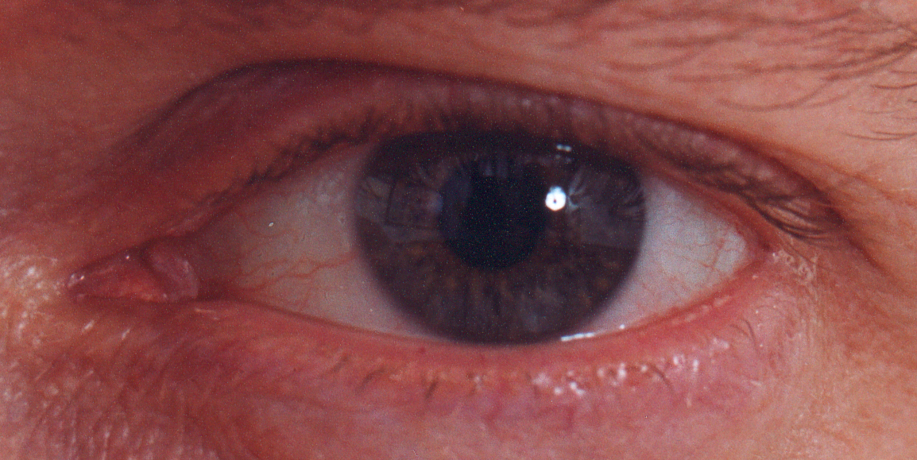
Biometrics

Slide 32
Something You Are
Biometric
“You are your key” ⎯ Schneier
Examples
Fingerprint
Handwritten signature
Facial recognition
Speech recognition
Gait (walking) recognition
“Digital doggie” (odor recognition)
Many more!
Are
Know
Have

Slide 33
Biometrics Authentication
May be better than passwords
But, cheap and reliable biometrics needed
Today, an active area of research
Biometric authentication involves using some part of your physical makeup to authenticate you.
Biometrics are used in security today
Thumbprint mouse
Palm print for secure entry
Fingerprint to unlock car door, etc.

Slide 34
Biometrics Authentication
A single characteristic or multiple characteristics could be used.
It all depends on the infrastructure and the level of security desired.
With biometric authentication, the physical characteristic being examined is usually mapped to a username. This username is used to make decisions after the person has been authenticated.
But biometrics not really that popular

Slide 35
Single Sign on (SSO)
Authenticating to multiple systems is unpopular with users.
Left on their own, users will reuse the same password to avoid having to remember many different passwords.
For example, users become frustrated at having to authenticate to a computer, a network, a mail system, an accounting system, and numerous web sites.
The panacea for this frustration is called single sign-on.
A user authenticates once per session, and the system forwards that authenticated identity to all other processes that would require authentication.

Slide 36
Security Assertion Markup Language (SAML)
SAML is a standard for logging users into applications based on their sessions in another context. This single sign-on (SSO) login standard has significant advantages over logging in using a username/password:
No need to type in credentials
No need to remember and renew passwords
No weak passwords
Most organizations already know the identity of users because they are logged in to their Active Directory domain or intranet.
It makes sense to use this information to log users in to other applications, such as web-based applications, and one of the more elegant ways of doing this is by using SAML.

Slide 37
SSO Protocol
Kerberos --- example single sign-on protocol
Kerberos is a computer-network authentication protocol that works on the basis of tickets to allow nodes communicating over a non-secure network to prove their identity to one another in a secure manner.
Its designers aimed it primarily at a client–server model, and it provides mutual authentication—both the user and the server verify each other's identity.

Slide 38
Thank you

